Slide 1
Lecture 10 Basic Graph Algorithms
Department of Computer Science
Hofstra University

Slide 2
Lecture Goals
Compare the Graph ADT with other ADTs
Define basic notions associated with graphs
Implement graphs using an adjacency matrix representation and an adjacency list representation
We introduce two classic algorithms for searching a graph—depth-first search and breadth-first search.
we introduce a depth-first search based algorithm for computing the topological sort of an acyclic digraph.

Slide 3
ADT of Graph
Sequential, linear structures
Arrays, linked lists
Hierarchical structures
Trees
Unstructured structures
Sets
Useful for
iterating over all elements,
accessing via index
Can indicate common structure in key
for example, the prefix in tire
Principle: Basic objects & Relationships between them
Graph is a generalization of this principle
Basic objects: vertices, nodes
Relationships between them: edges, arcs, links

Slide 4
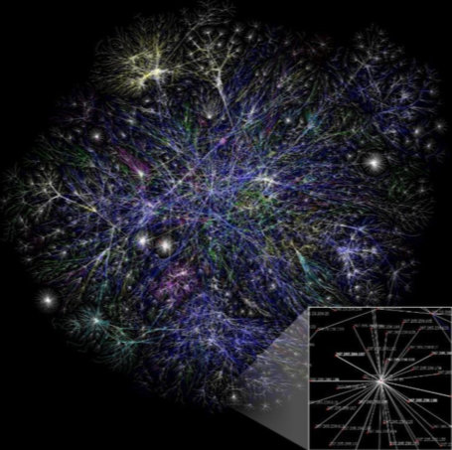
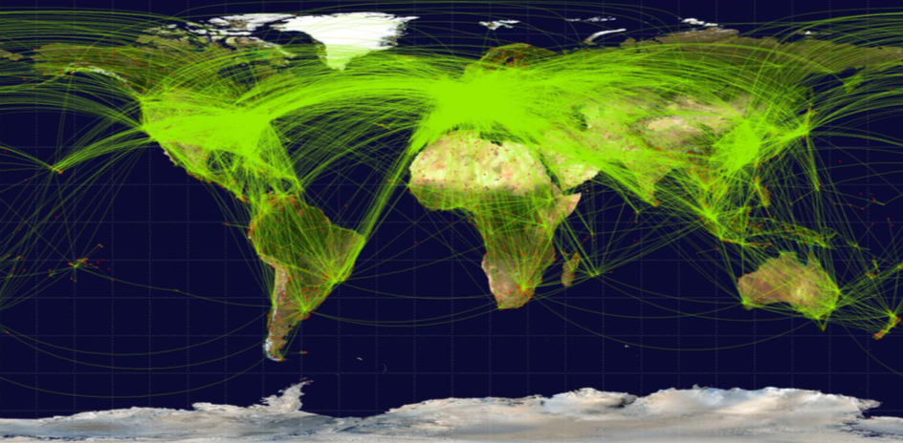
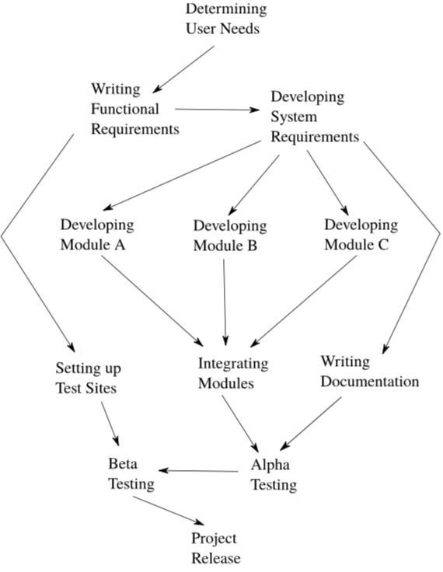

Examples of Graphs
Some general questions related to graphs:
How to create a graph?
Are two vertices adjacent?
Is the graph dense? sparse?
How far are two vertices in the graph?
How many components are there in the graph?
Can we find a vertex with particular key value?
Basic objects: cities
Relationships between them: nonstop flights
Basic objects: websites
Relationships between them: hyperlinks
Basic objects: people
Relationships between them: friends
Basic objects: tasks
Relationships between them: dependencies

Slide 5

Graph Definitions
Basic objects: vertices, nodes
Relationships between them: edges, arcs, links
V
Size of graph: |V| + |E|
|V|: number of vertices
|E|: number of edges
E
Neighbor: u is a neighbor of v if:
there is an edge from u to v
OR
there is an edge from v to u
1
3
start point
1
3
5
10
4
3
4
2
2
5
5
4
end point
6
17
6
What are the neighbors of the vertex 4?
3,4,5,6
3,5,6
3,6
5
Undirected
Directed
Weighted
cost
edges are symmetric
Path: sequence of vertices and edges that depicts hopping along graph
For which pair of vertices is there a path in the graph starting at the first and ending at the second?
A. vertex 1 and vertex 3
B. vertex 4 and vertex 6
C. vertex 6 and vertex 5
What's the maximum number of edges in a directed and undirected graph with n vertices?
Assume there are no self-loops (i.e. edges from a node back to itself).
Assume there there is at most one edge from a given start vertex to a given end vertex.
n*(n-1)
n*(n-1)/2

Slide 6
Implementing Graphs in Java
Basic objects: vertices, nodes
Relationships between them: edges, arcs, links
Label by integers
public abstract class Graph {
private int numVertices;
private int numEdges;
public Graph() {
numVertices = numEdges = 0;
}
public int getNumVertices() {
return numVertices;
}
public int getNumEdges() {
return numEdges;
}
public void addVertex() {
implementAddVertex();
numVertices++;
}
public abstract void implementAddVertex();
public abstract List<Integer> getNeighbors(int v);
}
size of a graph
data associated with any graph
methods that ought to be available with any graph.
leave implementation of key functionalities to subclasses
For example, which cities we can reach with nonstop flight?

Slide 7
Graph Representation: Adjacency Matrix
relabel vertices starting at 0 to use as index
array entry > 1:
multiple edges,
or weighted edges
start point
V = {0, 1, 2, 3, 4, 5}
Column index
0
2
0
1
2
3
4
5
3
row index
0
1
2
3
4
5
0
1
0
0
0
0
1
0
0
end point
4
0
0
0
0
0
0
5
Symmetric entry
0
0
0
1
0
0
5 edges in graph
→ 5 nonzero entries in adjacency matrix
0
0
0
0
0
0
0
0
0
1
0
0
public class GraphAdjMatrix extends Graph {
private int[][] adjMatrix;
public void implementAddEdge(int v, int w) {
adjMatrix[v][w] = 1;
}
public void implementAddVertex() {
int v = getNumVertices();
if (v >= adjMatrix.length) {
int[][] newAdjMatrix = new int[v * 2][v * 2];
for (int i = 0; i < adjMatrix.length; i++) {
for (int j = 0; j < adjMatrix.length; j++) {
newAdjMatrix[i][j] = adjMatrix[i][j];
}
}
adjMatrix = newAdjMatrix;
}
}}
0
0
0
1
1
0
The grid (2-d array) is indexed by the vertices labels and stores information in a particular location based on whether these two vertices have an edge between them or not
v*2 instead of v+1 to amortize cost of adding new vertices in the future.
How long does it take to test whether there is an edge between vertex v and vertex w in the graph?
O(1)
Algebraic representation of graph structure.
Fast to test for edges.
Fast to add/remove edges.
Slow to add/remove vertices.
Requires a lot of memory.
expand the 2-d array
Graph Implementations
https://www.youtube.com/watch?v=2guA5uMEmZQ
sparse
Notes:
// constructor, methods update the adjMatrix

Slide 8
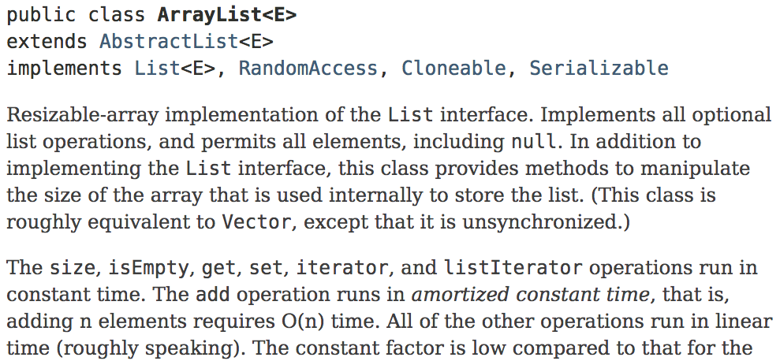
Graph Representation: Adjacency List
Neighbour can be reached by one hop
0
2
0 → {1}
3
Easy to add vertices.
Easy to add/remove edges.
May use a lot less memory than adjacency matrices.
1
1 → null
4
5
2 → {3}
3 → null
Motivation for new representation:
want to avoid storing information on edges that aren't in the graph
Edges connect a vertex to its neighbors
- Sparse graph: O(1) edges for each vertex
- most applications use sparse graphs
4 → {3}
5 → {3, 4}
Is it also fast?
public class GraphAdjList extends Graph {
private Map<Integer, ArrayList<Integer>> adjListsMap;
public void implementAddVertex() {
int v = getNumVertices();
ArrayList<Integer> neighbors = new ArrayList<Integer>();
adjListsMap.put(v, neighbors);
}
public void implementAddEdge(int v, int w) {
(adjListsMap.get(v)).add(w);
}
}
vertex → {neighbors}
Yes. Operations are all O(1)
Notes:
Graph Data Structure
http://www.tutorialspoint.com/data_structures_algorithms/graph_data_structure.htm
Representing Graphs, Adjacency matrix and list
https://www.khanacademy.org/computing/computer-science/algorithms/graph-representation/a/representing-graphs

Slide 9
Some Practices
0
How much storage is required to represent a graph as a matrix? (Big-O, Tightest Bound)
A. |V| B. |E|
C. |V|+|E| D. |V|² E. |E|²
1
3
4
2
5
0 1 2 3 4 5 6
6
0
1
2
3
4
5
6
0
0
0
1
0
0
0
O(|E|)
0
0
1
0
0
0
0
What would change if undirected?
1
0
0
0
0
0
0
0 → {3}
0
0
0
0
1
0
0
Symmetric matrix, hence half of the matrix is redundant, but still O(|V|²)
1 → {2}
0
0
0
0
0
0
0
0
0
0
0
1
0
0
2 → {0}
0
0
0
0
1
1
0
For dense graphs with lots of edges, |E| will be as large as |V|²
O(|V|)
3 → {4}
0 1 2 3 4 5 6
4 → null
0
1
2
3
4
5
6
0
0
1
1
0
0
0
0
0
1
0
0
0
0
How much storage is required to represent a graph as an adjacency list? (Big-O, Tightest Bound)
A. |V| B. |E|
C. |V|+|E| D. |V|² E. |E|²
5 → {4}
1
1
0
0
0
0
0
6 → {4, 5}
1
0
0
0
1
0
0
0
0
0
1
0
1
1
Much more efficient for sparse graphs!
0
0
0
0
1
0
1
0
0
0
0
1
1
0
Symmetric matrix

Slide 10
Find the Neighbors
0
2
Neighbors: vertices that are adjacent.
there is edge in between
outgoing edge
3
Out degree: number of outgoing edges.
1
4
5
In degree: number of incoming edges.
incoming edge
1
2
3
4
5
0
0 → {1}
0
1
2
3
4
5
0
1
0
0
0
0
0
0
1 → null
0
0
0
0
0
0
count the number of occurrences in all lists
0
0
0
1
0
0
2 → {3}
0
0
0
0
0
0
3 → null
0
0
0
1
0
0
count the number of nonzero slots
return the size of list
4 → {3}
0
0
0
1
1
0
5 → {3, 4}
Which implementation makes finding the in degree more efficient?
Which implementation makes finding the out degree more efficient?
Matrix: O(|V|) List: O(|E| + |V|)
For dense graphs without multiple edges between pairs of vertices, |E| is O(|V|²). so the adjacency matrix representation is faster. For sparse graphs, |E| = O(|V|) so both representations have the same performance.
Matrix: O(|V|) List: O(1)

Slide 11
Coding getOutNeighbors (outgoing)
getOutNeighbors(0)
public class GraphAdjMatrix extends Graph {
private int[][] adjMatrix;
public List<Integer> getOutNeighbors(int v) {
List<Integer> neighbors = new ArrayList<Integer>();
for (int i = 0; i < getNumVertices(); i++) {
for (int j=0; j< adjMatrix[v][i]; j++)
if (adjMatrix[v][i] > 0)
neighbors.add(i);
}
return neighbors;
}
}
0
1
3
// list to return
4
2
5
array entry > 1:
multiple edges
6
getOutNeighbors(6)
0 1 2 3 4 5 6
0 → {3}
0
1
2
3
4
5
6
0
0
0
1
0
0
0
1 → {2}
2
public class GraphAdjList extends Graph {
private Map<Integer,ArrayList<Integer>> adjListsMap;
public List<Integer> getOutNeighbors(int v) {
return adjListsMap.get(v);
return new ArrayList<Integer>(adjListsMap.get(v));
}
}
0
0
1
0
0
0
0
2 → {0}
1
0
0
0
0
0
0
0
0
0
0
1
0
0
3 → {4}
0
0
0
0
0
0
0
4 → null
// return v’s list
0
0
0
0
1
0
0
0
0
0
0
1
1
0
5 → {4}
// return a COPY of v’s list
6 → {4, 5}
Returning the array pointer allows the caller to modify the list contents. Not good encapsulation.
What does this change do?
It's a change in the code but will not materially affect the output.
It allows multiple edges between two vertices.
It will have some other effect on the code behavior.

Slide 12
Coding 2-Hop Neighbors (outgoing)
Find all two-hop neighbors from given vertex
0
1
public class GraphAdjList extends Graph {
private Map<Integer,ArrayList<Integer>> adjListsMap;
public List<Integer> getDistance2 (int v) {
List<Integer> distance2 = new ArrayList<>();
// Loop through oneHop and get the neighbors of each
for(int u : getOutNeighbors(v)){
distance2.addAll(getOutNeighbors(u));
}
return distance2;
}
}
2
3
0 → {1, 2}
1 → {3}
2 → {1, 3}
3 → null
public class GraphAdjMatrix extends Graph {
private int[][] adjMatrix;
public List<Integer> getDistance2 (int v) {
List<Integer> distance2 = new ArrayList<Integer>();
// Loop through oneHop and get the neighbors of each
for(int u : getOutNeighbors(v)){
distance2.addAll(getOutNeighbors(u));
}
return distance2;
}
}
0 1 2 3
0
1
2
3
0
1
1
0
0
0
0
1
0
1
0
1
0
0
0
0

Slide 13
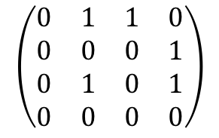
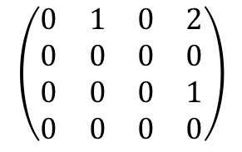
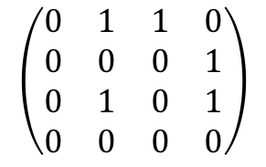
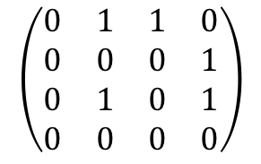
Coding 2-Hop Neighbors (Matrix Multiplication)
0
1
Matrix multiplication for finding two-hop neighbors
2
For all the vertices in the graph
2
3
$$\left(\begin{matrix}0 & 1 & 1 & 0 \\ 0 & 0 & 0 & 1 \\ 0 & 1 & 0 & 1 \\ 0 & 0 & 0 & 0\end{matrix}\right)$$
=
matrix whose entries are two-hop neighbors!
0 1 2 3
0
1
2
3
0
1
1
0
0
0
0
1
$$\left(\begin{matrix}0 & 1 & 1 & 0 \\ 0 & 0 & 0 & 1 \\ 0 & 1 & 0 & 1 \\ 0 & 0 & 0 & 0\end{matrix}\right)$$
$$\left(\begin{matrix}0 & 1 & 1 & 0 \\ 0 & 0 & 0 & 1 \\ 0 & 1 & 0 & 1 \\ 0 & 0 & 0 & 0\end{matrix}\right)$$
$$\left(\begin{matrix}0 & 1 & 0 & 2 \\ 0 & 0 & 0 & 0 \\ 0 & 0 & 0 & 1 \\ 0 & 0 & 0 & 0\end{matrix}\right)$$
0
1
0
1
=
0
0
0
0
Node 3 is a two-hop neighbor of node 0 along two different paths
Dot product
0 1 2 3
0*0 + 1*0 + 1*0 + 0*0 = 0
0*0 + 1*1 + 1*1 + 0*0 = 2
0
1
2
3
0
1
0
2
0
0
0
0
0*1 + 1*0 + 1*1 + 0*0 = 1
0*0 + 0*0 + 0*0 + 1*0 = 0
0
0
0
1
0
0
0
0
0*1 + 1*0 + 1*0 + 0*0 = 0
Matrix multiplication is well studied and optimized in software and hardware, and can be done very fast

Slide 14
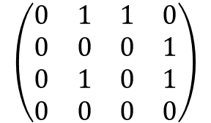
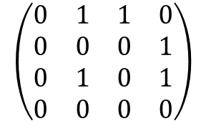
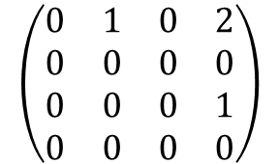
Coding 2-Hop Neighbors (Matrix Multiplication)
Consider the multiplication of the first row of the left matrix wit the last column of the right matrix:
0*0 + 1*1 + 1*1 + 0*0 = 2.
This means that there are two 2-hop paths from 1 to 3:
Path 0→1→ 3 consisting of two edges 0→1 & 1→ 3, corresponding to the first term of 1*1
Path 0→2→ 3 consisting of two edges 0→2 &2→ 3, corresponding to the second term of 1*1
Path 0→1→ 3
$$\left(\begin{matrix}0 & 1 & 1 & 0 \\ 0 & 0 & 0 & 1 \\ 0 & 1 & 0 & 1 \\ 0 & 0 & 0 & 0\end{matrix}\right)$$
$$\left(\begin{matrix}0 & 1 & 1 & 0 \\ 0 & 0 & 0 & 1 \\ 0 & 1 & 0 & 1 \\ 0 & 0 & 0 & 0\end{matrix}\right)$$
$$\left(\begin{matrix}0 & 1 & 0 & 2 \\ 0 & 0 & 0 & 0 \\ 0 & 0 & 0 & 1 \\ 0 & 0 & 0 & 0\end{matrix}\right)$$
0
1
=
2
3
Path 0→2→ 3

Slide 15

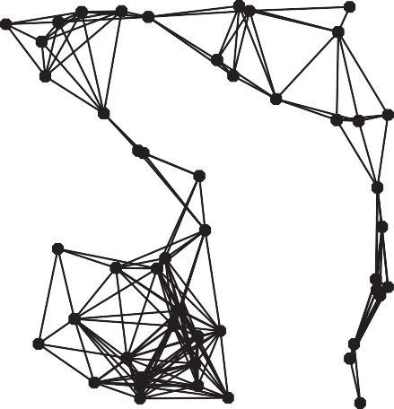
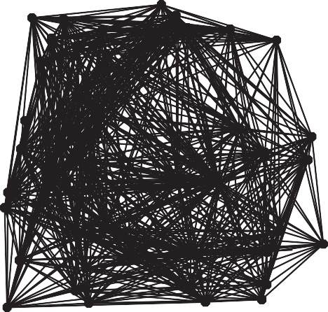
Summary of Digraph Representations
In practice. Use adjacency-lists representation.
Algorithms based on iterating over vertices adjacent from v.
Real-world graphs tend to be sparse (not dense).
proportional to V
proportional to V²
sparse (E = 200)
dense (E = 3000)
Two graphs (V = 50)
representation
space
insert edge from v to w
edge from v to w?
iterate over vertices adjacent from v?
adjacency matrix
V ²
1
1
V
adjacency lists
E + V
1
outdegree(v)
outdegree(v)
† disallows parallel edges

Slide 16
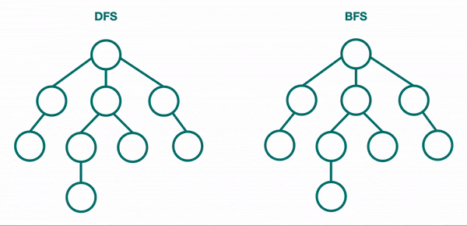
DFS vs. BFS

Slide 17
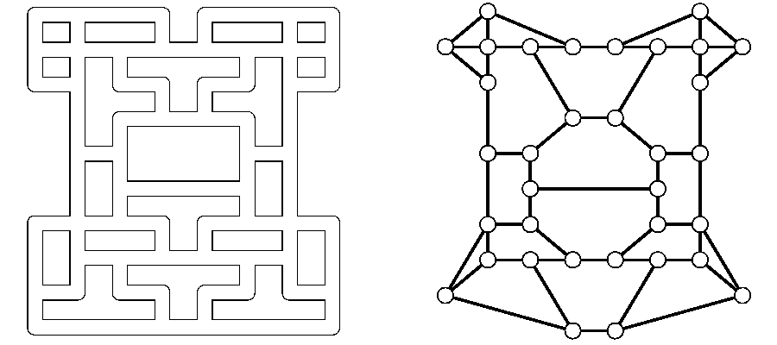
Represent Problems as Graphs: Maze Exploration
Goal. Explore every intersection in the maze.
Maze graph. Vertex = intersection. Edge = passage.
intersection
passage

Slide 18
Depth-First Search (DFS)
Goal. Systematically traverse a graph.
DFS (to visit a vertex v)
Mark vertex v.
Recursively visit all unmarked vertices w adjacent to v.
Typical applications.
Find all vertices connected to a given source vertex.
Find a path between two vertices.
0
Java execution stack is used to keep track of where to search next
7
8
v marked[ ]
edgeTo[ ]
0
1
2
3
4
5
6
7
8
9
10
11
F
F
F F F F F
F F F F F
–
–
–
–
–
––
–
–
–
–
–
dfs(0)
dfs(6)
dfs(4)
dfs(5)
dfs(3)
3 done
5 done
4 done
6 done
dfs(2)
2 done
dfs(1)
1 done
0 done
T
T
0
1
2
6
T
0
9
T
5
3
4
T
6
T
4
10
11
T
0
5
Data structures.
Boolean array marked[] to mark vertices.
Integer array edgeTo[] to keep track of paths.
(edgeTo[w] == v) means that edge v-w taken to discover vertex w

Slide 19
Depth-First Search: Java Implementation
public class DepthFirstPaths {
private boolean[] marked; private int[] edgeTo; private int s;
marked[v] = true if v connected to s
edgeTo[v] = previous vertex on path from s to v
public DepthFirstPaths(Graph G, int s) {
...
dfs(G, s);
}
initialize data structures
find vertices connected to s
private void dfs(Graph G, int v) {
marked[v] = true;
for (int w : G.adj(v))
if (!marked[w])
{
edgeTo[w] = v; dfs(G, w);
}
}
recursive DFS does the work
}
Code for directed graphs identical to undirected one.

Slide 20

Depth-First Search Application: Flood Fill
Problem. Flood fill is a flooding algorithm that determines and alters the area connected to a given node in a multi-dimensional array with some matching attribute.
Solution.
Build a grid graph.
Vertex: pixel.
Edge: between two adjacent gray pixels.
Blob: all pixels connected to given pixel.
https://en.wikipedia.org/wiki/Flood_fill

Slide 21


Reachability Application: Mark–Sweep Garbage Collector
Every data structure is a digraph.
Vertex = object.
Edge = reference.
Roots: Objects known to be directly accessible by program (e.g., stack).
Reachable objects: Objects indirectly accessible by program (starting at a root and following a chain of pointers).
Mark–sweep algorithm. [McCarthy, 1960]
Mark: mark all reachable objects.
Sweep: if object is unmarked, it is garbage (so add to free list).
Memory cost. Uses 1 extra mark bit per object (plus DFS stack).
roots

Slide 22
Recall from Lecture 2-classes and objects in java
public class Location
{
// Code omitted here
public static void main(String[] args)
{
Location loc1 = new Location(40.7, -73.6);
Location loc2 = new Location(51.7 , -1.2);
loc1 = loc2;
loc1.latitude = 35.2;
System.out.println(loc2.latitute + ”, " + loc2.longitude);
After assignment loc1 = loc2, the Object Location(40.7, -73.6) is unreachable and should be garbage-collected.
Location Object
Latitude
40.7
@1
@1
loc1
@2
Longitude
-73.6
$ 35.2, -1.2
Location Object
loc2
@2
Latitude
35.2
51.7
@2
Longitude
-1.2

Slide 23
Breadth-First Search (BFS)
BFS (from source vertex s)
Put s onto a FIFO queue, and mark s as visited.
Repeat until the queue is empty:
remove the least recently added vertex v
add each of v's unmarked neighbors to the queue, and mark them.
4
Queue
3
5
1
2
0
0
2
v marked[ ] edgeTo[ ] distTo[ ]
0
1
2
3
4
5
T
– –
–
–
–
–
0 –
–
–
–
–
F
F
F
F
F
F
1
T
0
1
T
0
1
T
2
2
3
T
2
2
5
4
T
0
1
distTo[v] = distTo[edgeTo[v]] + 1;
s.distTo[v] stores the distance from s to v

Slide 24
Breadth-First Search: Java Implementation
public class BreadthFirstPaths {
private boolean[] marked; private int[] edgeTo; private int[] distTo;
…
DFS. Put unvisited vertices on a stack.
BFS. Put unvisited vertices on a queue.
private void bfs(Graph G, int s) { Queue<Integer> q = new Queue<Integer>(); q.enqueue(s);
marked[s] = true; distTo[s] = 0;
while (!q.isEmpty()) { int v = q.dequeue();
for (int w : G.adj(v)) {
if (!marked[w]) { q.enqueue(w); marked[w] = true; edgeTo[w] = v;
distTo[w] = distTo[v] + 1;
}
}
}
}
initialize FIFO queue of vertices to explore
found new vertex w via edge v–w
Every undirected graph is a digraph (with edges in both directions).
Code for directed graphs identical to undirected one.
Function G.adj(v) returns all neighbors in the edge arrow direction.
}

Slide 25



Breadth-First Search Properties
level-order
Proposition. BFS examines vertices in increasing distance (number of edges) from s.
Proposition. In any connected graph, BFS computes shortest paths (fewest number of edges) from s to all other vertices in time proportional to E + V.
Pf. [correctness] Queue always consists of zero or more vertices of distance k from s, followed by zero or more vertices of distance k + 1.
Pf. [running time] Each vertex connected to s is visited once, and all its edges are checked.
s
0
2
1
4
1
0 2
3
3
5
4
5
graph G
dist = 0
dist = 1
dist = 2

Slide 26


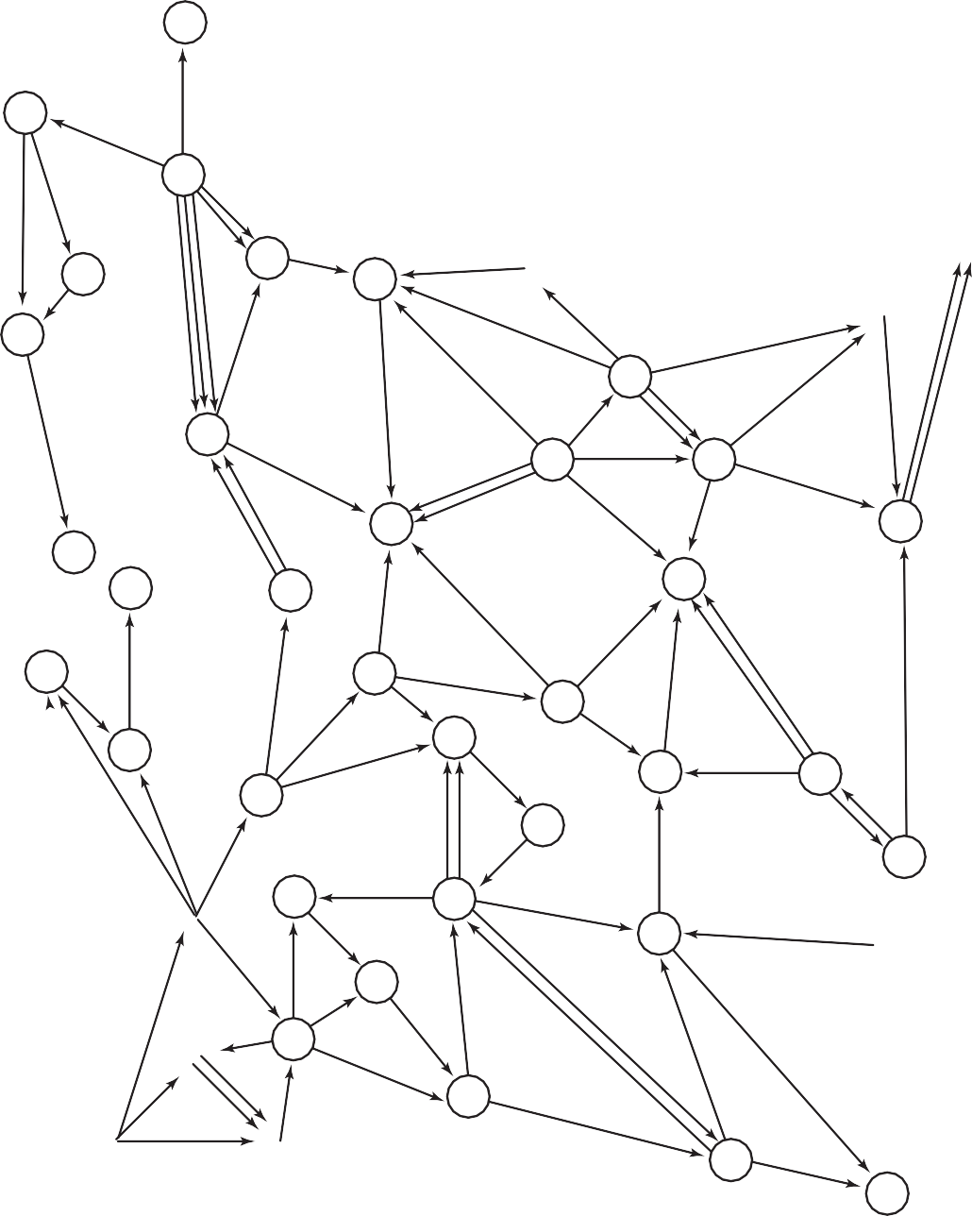









Breadth-First Search Application: Web Crawler
Goal. Crawl web, starting from some root web page, say www.hofstra.edu.
0
34
25
7
10
40
2
Solution. [BFS with implicit digraph]
Choose root web page as source s.
Maintain a Queue of websites to explore.
Maintain a SET of marked websites.
Dequeue the next website and enqueue any unmarked websites to which it links.
29
19
33
41
49
15
44
8
45
28
1
14
39
22
48
18
6
21
42
13
23
31
47
11
12
32
30
26
27
5
37
9
43
16
4
24
38
36
3
17
35
20
46

Slide 27
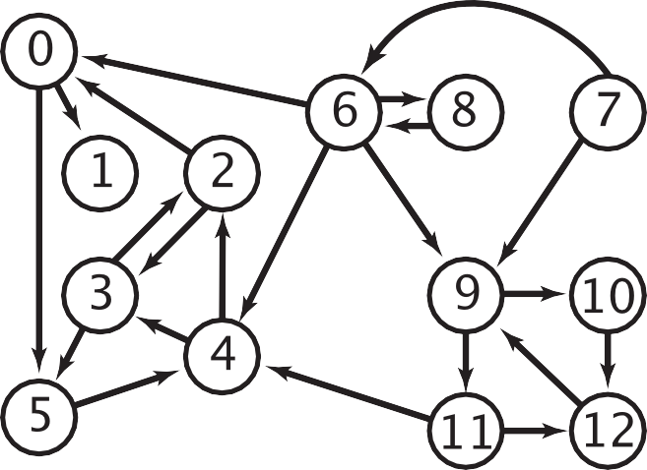
Multiple-Source Shortest Paths Problem
Given a digraph and a set of source vertices, find shortest path from any vertex in the set to each other vertex, assuming all edges have weight 1.
Ex. S = { 1, 7, 10 }.
Shortest path to 4 is 7 → 6 → 4.
Shortest path to 5 is 7 → 6 → 0 → 5.
Shortest path to 12 is 10 → 12.
…
How to implement multi-source shortest paths algorithm?
0
1
6
5
8
Use BFS, but initialize by enqueuing all source vertices.
7
9
2
4
10
12
3
11
dist = 0
dist = 1
dist = 2
dist = 3

Slide 28
Connectivity Queries Problem
Vertices v and w are connected if there is a path between them.
In undirected graph, the relation "is connected to" is an equivalence relation:
Reflexive: v is connected to v.
Symmetric: if v is connected to w, then w is connected to v.
Transitive: if v connected to w and w connected to x, then v connected to x.
Goal. Preprocess undirected graph to answer queries of the form is v connected to w? in constant time while using adjacency list.
A connected component is a maximal set of connected vertices.
Given connected components, can answer queries in constant time.
v
id[ ]
0
0
1
2
3
4
5
6
7
8
9
10
11
0
0
0
0
0
0
1
1
2
2
2
public class | CC
boolean int int | CC(Graph G) connected(int v, int w) count() id(int v) | find connected components in G are v and w connected? number of connected components component identifier for v
0
7
8
1
2
6
9
3
4
5
10
11
3 connected components

Slide 29
Finding Connected Components with DFS
Goal. Partition vertices into connected components.
Java execution stack
Connected components
dfs(0)
dfs(6)
dfs(4)
dfs(5)
dfs(3)
3 done
5 done
4 done
6 done
dfs(2)
2 done
dfs(1)
1 done
0 done
dfs(7)
dfs(8)
8 done
7 done
dfs(9)
dfs(10)
dfs(11)
11 done
10 done
9 done
Initialize all vertices v as unmarked.
For each unmarked vertex v, run DFS to identify all vertices discovered as part of the same component.
v marked[ ]
id[ ]
0
1
2
3
4
5
6
7
8
9
10
11
–
–
–
–
–
––
–
–
–
–
–
F
F
F F F F F
F F F F F
0
T
T
0
T
0
0
7
8
T
0
T
0
T
0
T
0
1
2
6
T
1
9
T
1
3
4
T
2
T
2
10
11
T
2
5
Can also use BFS

Slide 30

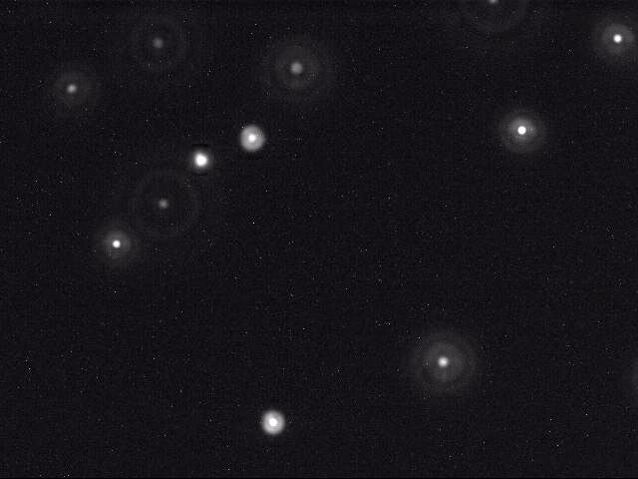






























Connected Components Application: Particle Detection
Given grayscale image of particles, identify "blobs."
Vertex: pixel.
Edge: between two adjacent pixels with grayscale value > 70.
Blob: connected component of 20-30 pixels.
black = 0
white = 255
Particle tracking. Track moving particles over time.

Slide 31
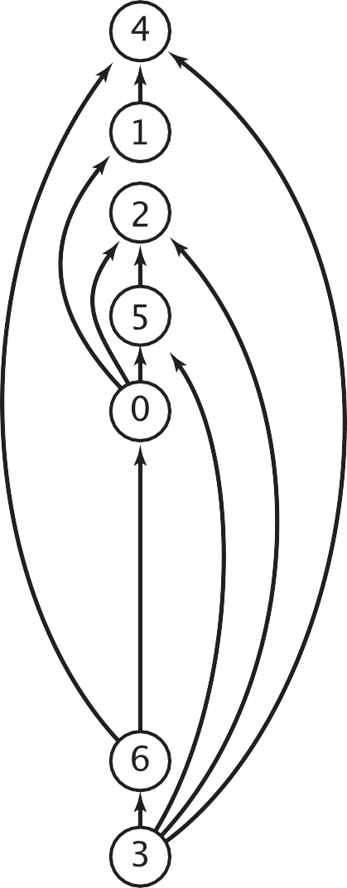
Precedence Scheduling Problem
Goal. Given a set of tasks to be completed with precedence constraints, in which order should we schedule the tasks?
Digraph model. vertex = task; edge = precedence constraint.
DAG
0. Algorithms
1. Complexity Theory
2. Artificial Intelligence
3. Intro to CS
4. Cryptography
5. Scientific Computing
6. Advanced Programming
0
2
5
1
3
4
6
tasks
precedence constraint graph
feasible schedule
Topological sort. Redraw DAG(Directed acyclic graph) so all edges point upwards.

Slide 32
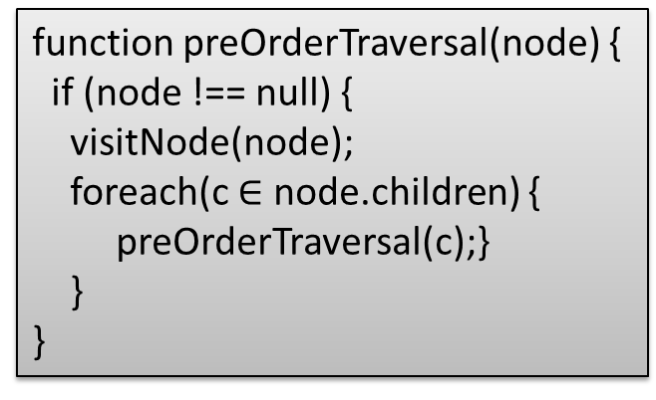
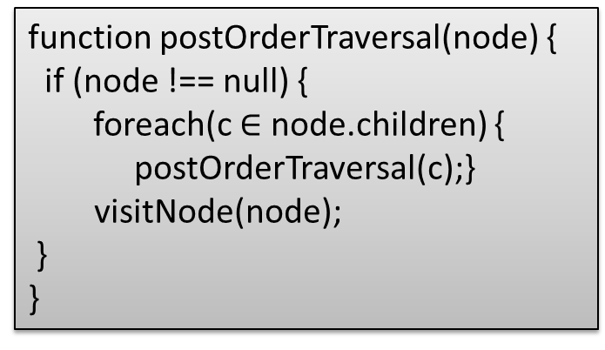
Graph traversal with DFS: pre-order, post-order
function preOrderTraversal(node) {
if (node !== null) {
visitNode(node);
preOrderTraversal(node.left);
preOrderTraversal(node.right);
}
}
function postOrderTraversal(node) {
if (node !== null) {
postOrderTraversal(node.left);
postOrderTraversal(node.right);
visitNode(node);
}
}
Recall: Binary Tree traversal with DFS: pre-order, post-order
function preOrderTraversal(node) {
if (node !== null) {
visitNode(node);
foreach(c $∈$ node.children) {
preOrderTraversal(c);}
}
}
function postOrderTraversal(node) {
if (node !== null) {
foreach(c $∈$ node.children) {
postOrderTraversal(c);}
visitNode(node);
}
}
Graph traversal with DFS: pre-order, post-order
Notes:
https://skilled.dev/course/tree-traversal-in-order-pre-order-post-order

Slide 33
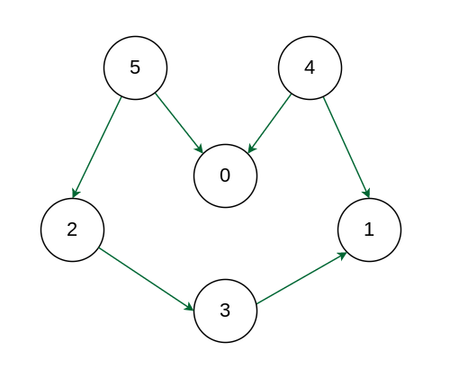
Topological Sort
Topological sort for Directed Acyclic Graph (DAG) is a linear ordering of vertices such that for every directed edge u-v, vertex u comes before v in the ordering, i.e., all pair-wise precedence constraints are satisfied.
The first vertex in topological sortis always a vertex with an in-degree of 0 (a vertex with no incoming edges), i.e., 4 or 5. Possible topological sorts include
“5 4 2 3 1 0”, “4 5 2 3 1 0”, “4 5 0 2 3 1”, “5 2 3 4 1 0”, etc.
https://www.geeksforgeeks.org/topological-sorting/

Slide 34
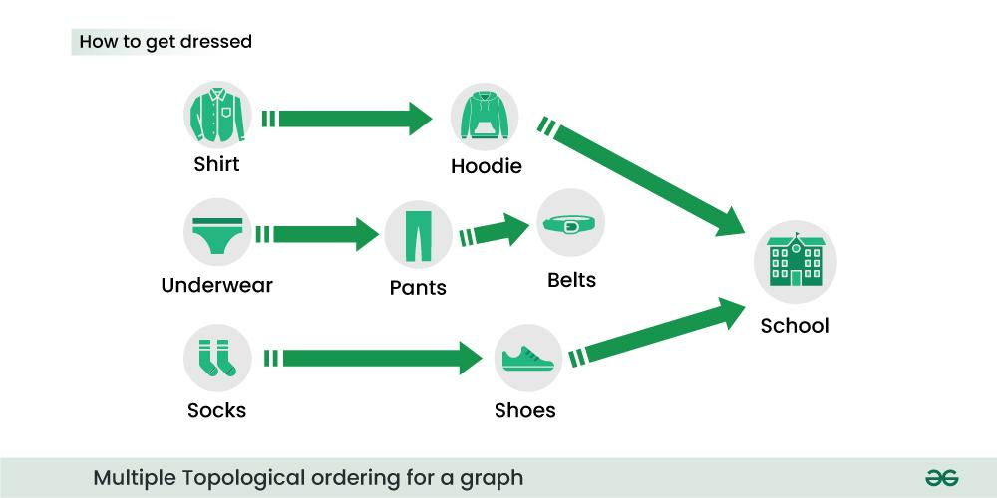
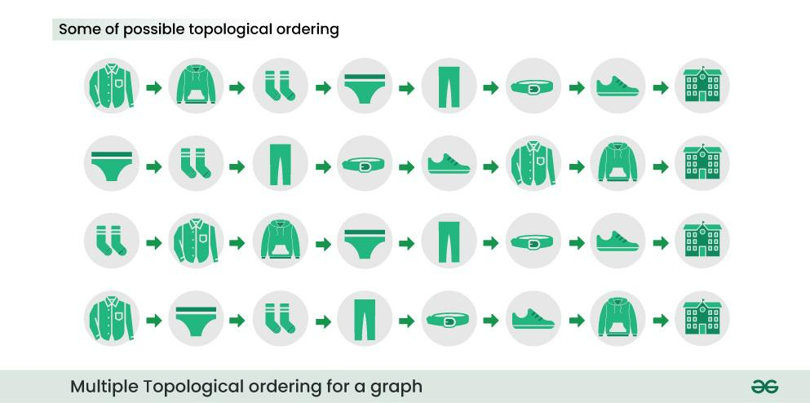
Topological Sort Example

Slide 35
Topological Sort Applications
Task scheduling and project management.
Dependency resolution in package management systems.
Determining the order of compilation in software build systems with Makefile
Deadlock detection in operating systems.
Course scheduling in universities.

Slide 36
Topological Sort by DFS Post-Order Traversal
Perform DFS Post-Order Traversal starting from a node with no incoming edges to get an ordered list of nodes, then reverse the node order to get a Topological Sort
Upon finishing traversal starting from one node, restart from another unvisited node with no incoming edges
This results in one of multiple possible Topological Sorts
Intuition: DFS Post-Order Traversal outputs nodes from the deepest (furthest away from the starting node) to the starting mode, hence the reverse order is a Topological Sort

Slide 37
Topological Sort Example
Java execution stack
not a reachability problem
dfs(0)
dfs(1)
dfs(4)
4 done
1 done
dfs(2)
2 done
dfs(5)
check 2
5 done
0 done
check 1
check 2
dfs(3)
check 2
check 4
check 5
dfs(6)
check 0
check 4
6 done
3 done
check 4
check 5
check 6
done
Run depth-first search
Return vertices in reverse postorder.
stack top
Postorder
4
1
2
5
0
6
3
0
0
topological sort
3
6
0
5
2
1
4
pop from the stack → reversed postorder
2
5
1
v marked[ ]
0
1
2
3
4
5
6
F
F
F F F F F
T
T
T
3
4
T
T
T
T
6
Notes:
from every unmarked vertex

Slide 38
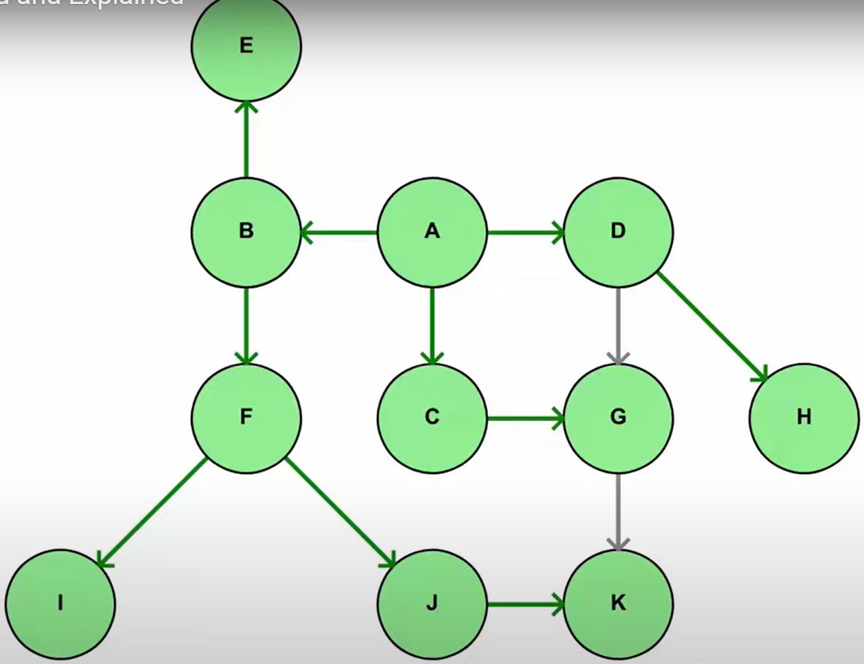
Example 1: Topological Sort
Starting from node A:
Pre-order traversal is “A B F I J K E C G D H”.
Post-order traversal is “I K J F E B G C H D A”.
A topological sort is reverse order of Post-order traversal: “A D H C G B E F J K I”.
Starting from a different node will give you a different topological sort, but all of them must start with A, since it must precede all the other nodes based on the DAG.
Any post-order traversal must visit A last, since all of A’s neighbors must be visited before visiting A.
Topological Sort Visualized and Explained
https://www.youtube.com/watch?v=7J3GadLzydI

Slide 39
Example 2: Topological Sort
Starting from node 5:
Pre-order traversal is “5 2 3 1 0 4”.
Post-order traversal is “1 3 2 0 5 4”.
A topological sort is reverse order of Post-order traversal: “4 5 0 2 3 1”.
Starting from node 4:
Pre-order traversal is “4 0 1 5 2 3”
Post-order traversal is “0 1 4 3 2 5”.
Another topological sort is reverse order of Post-order traversal: “5 2 3 4 1 0”.
Starting from node 0:
Pre-order traversal is “0 5 2 3 1 4”
Post-order traversal is “0 1 3 2 5 4”.
Another topological sort is reverse order of Post-order traversal: “4 5 2 3 0”.
You may try starting any other node.
Notes:
Starting from node 0:
Pre-order traversal is “0 5 2 3 1 4” or “0 4 1 5 2 3” .
Post-order traversal is “0 1 3 2 5 4”.
A topological sort is reverse order of Post-order traversal: “4 5 2 3 1 0”.
Starting from node 3:

Slide 40
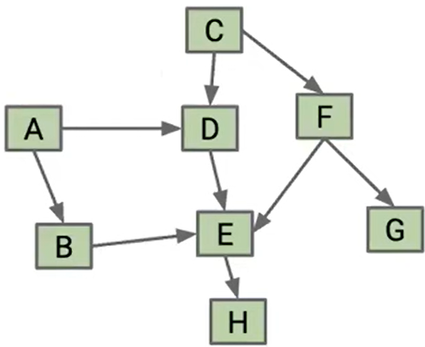
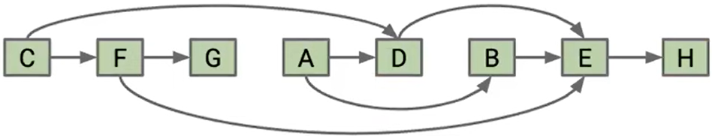
Example 3: Topological Sort
Starting from node A, post-order traversal is “H, E, B, D, A, G, F, C”; Topological Sort is “C, F, G, A, D, B, E, H”
Quiz: Starting from node C, post-order traversal is “ ”; Topological Sort is “ ”
Topological Sort. All edges point to the right hence all precedence constraints are satisfied
Graph
[61B SP24] Lecture 26 - MSTs (continued), Directed Acyclic Graphs
https://www.youtube.com/watch?v=HtXDt0gDvk4
Notes:
C, D, E, H, F, G, A, B

Slide 41
Cycles and undirected edges
Why is topological sort not possible for graphs containing cycles?
Imagine a graph with 3 vertices and edges = {1 to 2 , 2 to 3, 3 to 1} forming a cycle. Now if we try to topologically sort this graph starting from any vertex, it will always create a contradiction to our definition. All the vertices in a cycle are indirectly dependent on each other hence topological sortfails.
Why is topological sort not possible for graphs with undirected edges?
Special case of a cycle. Undirected edge between two vertices u and v means, there is an edge from u to v as well as from v to u. Because of this both the nodes u and v depend upon each other and none of them can appear before the other in the topological sortwithout creating a contradiction.

Slide 42
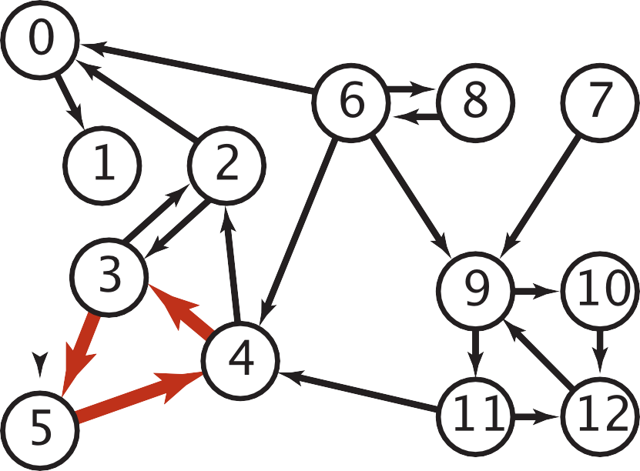

Topological Sort: Java Implementation
public class DepthFirstOrder {
private boolean[] marked;
private Stack<Integer> reversePostorder;
public DepthFirstOrder(Digraph G) {
reversePostorder = new Stack<Integer>();
marked = new boolean[G.V()];
for (int v = 0; v < G.V(); v++)
if (!marked[v]) dfs(G, v);
}
private void dfs(Digraph G, int v) {
marked[v] = true;
for (int w : G.adj(v))
if (!marked[w]) dfs(G, w); reversePostorder.push(v);
}
Proposition. A digraph has a topological sort iff no directed cycle.
Pf.
If directed cycle, topological sort impossible.
If no directed cycle, DFS-based algorithm finds a topological sort.
public Iterable<Integer> reversePostorder()
{ return reversePostorder; }
a digraph with a directed cycle
Goal. Given a digraph, find a directed cycle.
Solution. DFS. See next slide.
}
returns all vertices in “reverse DFS postorder”

Slide 43
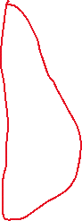

Directed Cycle Detection
Run depth-first search from every unmarked vertex.
Keep track of vertices currently in recursion stack of function for DFS traversal with onStack[ ] array.
If we reach a vertex that is already in the recursion stack, then we found a cycle in the tree, and we’re done
Retrieve the cycle using edgeTo[ ] array.
set onStack[v] to T when dfs(v) is called
set onStack[v] to F when dfs(v) returns
The other cycle can be detected when node 6 is visited
Java execution stack
0
v marked[ ]
onStack[ ]
edgeTo[ ]
0
1
2
3
4
5
6
F
F
F F F F F
F
F
F F F F F
–
–
–
–
–
––
dfs(0)
dfs(1)
dfs(4)
4 done
1 done
dfs(2)
dfs(3)
check 4
dfs(5)
check 2
done
T
T
T
T
0
T
T
0
2
5
1
T
T
2
T
T
1
T
T
3
3
4
stack top
2
3
5
2
Vertex 2 is marked and onStack
Found the cycle
Save the cycle using edgeTo[ ] to a stack
6
https://favtutor.com/blogs/detect-cycle-in-directed-graph

Slide 44
Directed Cycle Detection Application: Cyclic Inheritance
The Java compiler does cycle detection.
public class A extends B
{
...
}
% javac A.java
A.java:1: cyclic inheritance involving A
public class A extends B { }
^
1 error
public class B extends C
{
...
}
public class C extends A
{
...
}

Slide 45
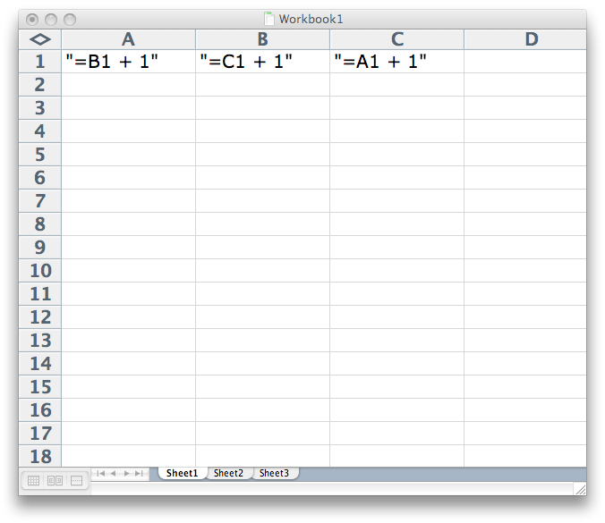

Directed Cycle Detection Application: Spreadsheet Recalculation
Microsoft Excel does cycle detection.

Slide 46
Kahn’s algorithm for Topological Sort
The algorithm works by repeatedly finding vertices with no incoming edges, removing them from the graph, and updating the incoming edges of the remaining vertices. This process continues until all vertices have been ordered.
Add all nodes with in-degree 0 to a queue.
While the queue is not empty:
Remove a node from the queue.
For each outgoing edge from the removed node, decrement the in-degree of the destination node by 1.
If the in-degree of a destination node becomes 0, add it to the queue.
If the queue is empty and there are still nodes in the graph, the graph contains a cycle and cannot be topologically sorted.
The nodes in the queue represent the topological sortof the graph.
Time Complexity: O(V+E).
The outer for loop will be executed V number of times and the inner for loop will be executed E number of times.
https://www.geeksforgeeks.org/topological-sorting-indegree-based-solution/

Slide 47
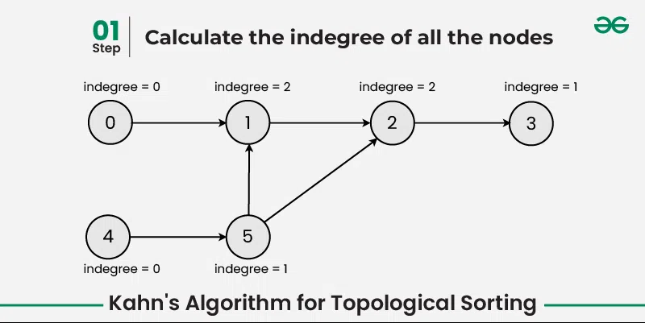
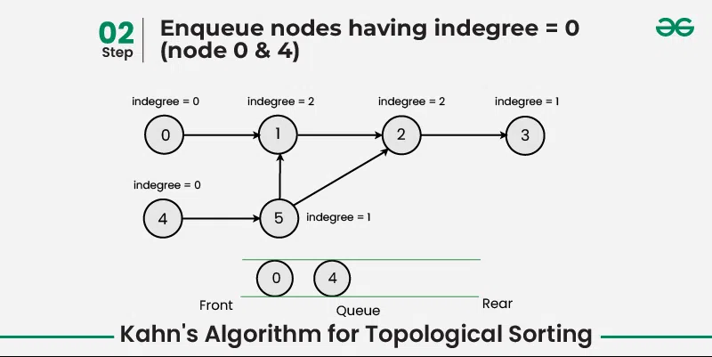
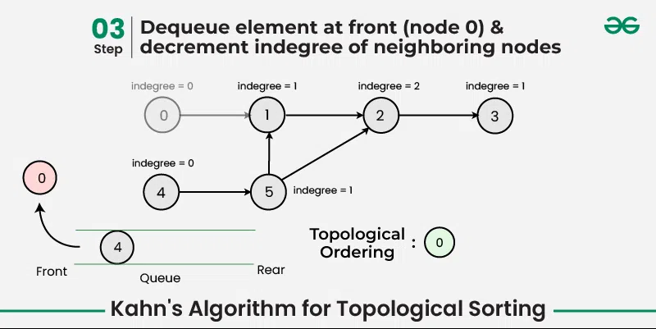
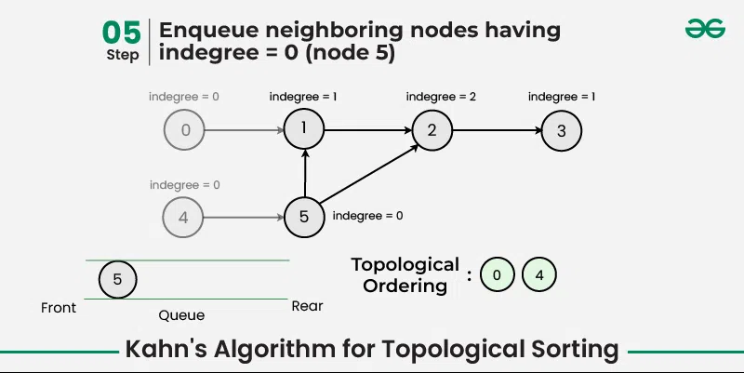
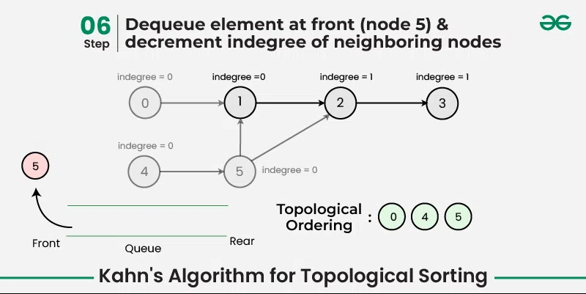
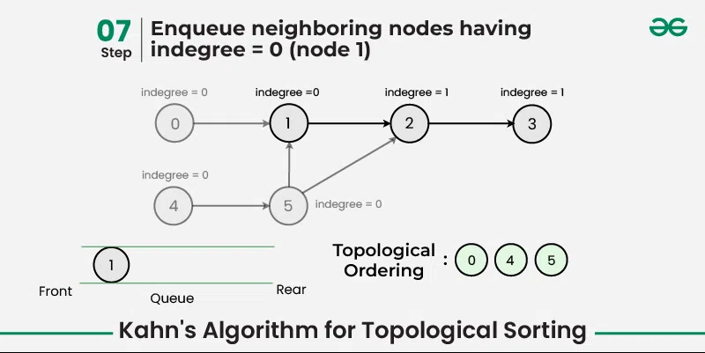

Slide 48
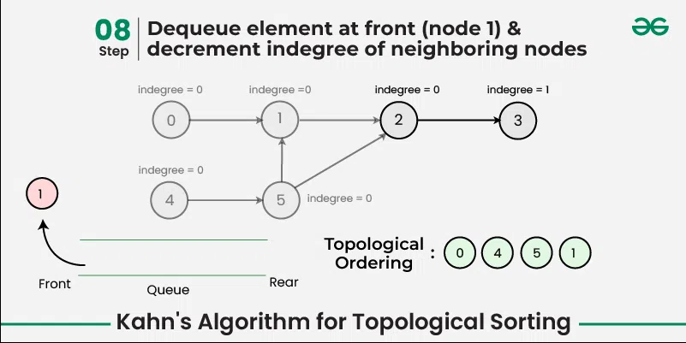
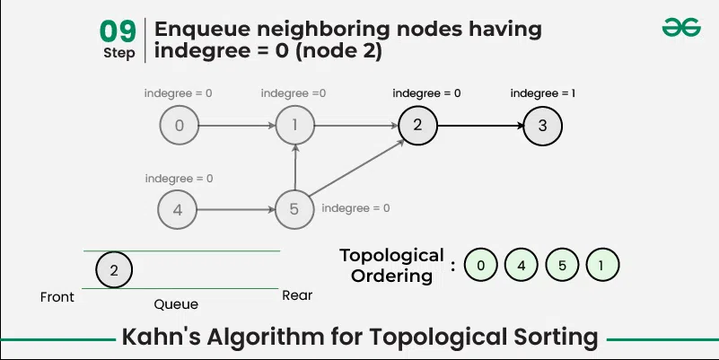
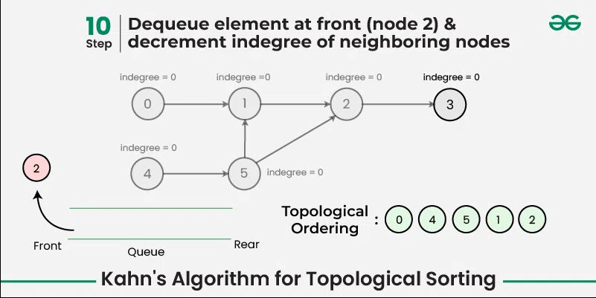
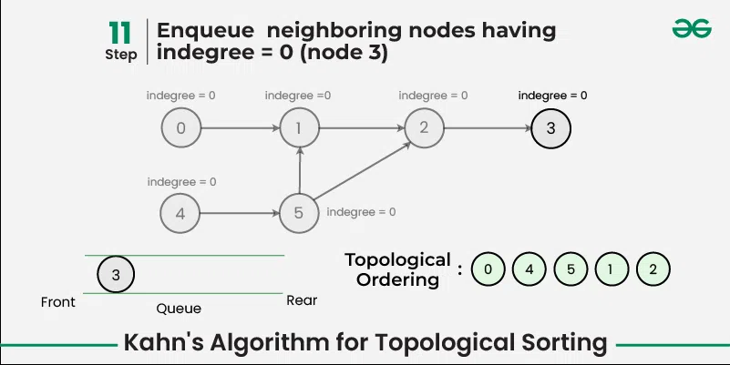
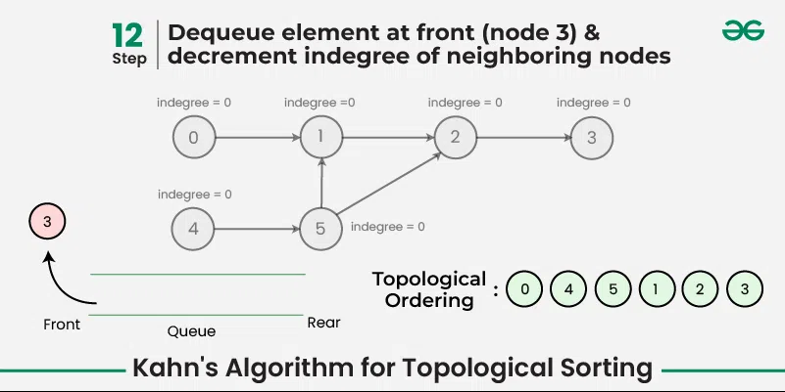
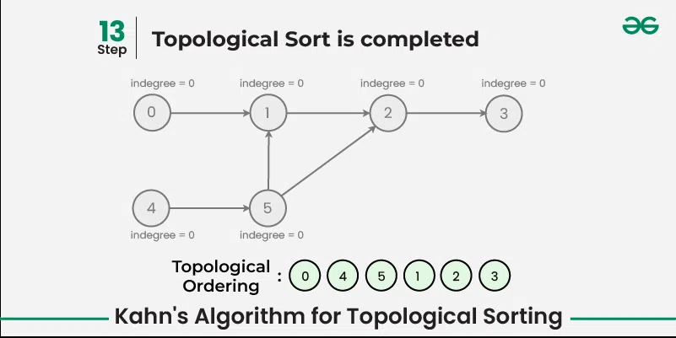

Slide 49
Video Tutorials: DFS and BFS
Breadth-first search in 4 minutes (for a tree)
https://www.youtube.com/watch?v=HZ5YTanv5QE
Depth-first search in 4 minutes (for a tree)
https://www.youtube.com/watch?v=Urx87-NMm6c
Graph Traversals - Breadth First and Depth First (for an undirected graph)
https://www.youtube.com/watch?v=bIA8HEEUxZI
Notes:
Depth First Search Algorithm
https://www.youtube.com/watch?v=iaBEKo5sM7w
Breadth First Search Algorithm
https://www.youtube.com/watch?v=QRq6p9s8NVg

Slide 50
Quiz 1
Write out the adjacency matrix and adjacency list for the directed graph.
C
B
F
G
D
A
E
Acknowledgement: https://sp24.datastructur.es/

Slide 51
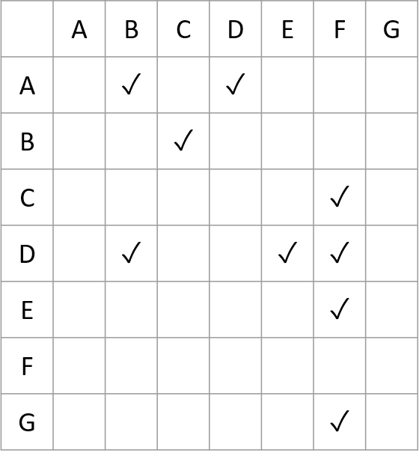
Adjacency Matrix
To
C
B
F
G
D
A
E
From

Slide 52
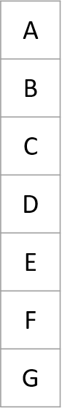
Adjacency List
B, D
C
C
F
B
F
G
B, F, E
D
F
A
E
F

Slide 53
Quiz 2
Write out the adjacency matrix and adjacency list for the undirected graph.
C
B
F
G
D
A
E

Slide 54

Adjacency Matrix
C
B
F
G
D
A
E

Slide 55
Adjacency List
B, D
C
A, C, D
B
F
G
B, F
A, B, E, F
D
D, F
A
E
C, D, E, G
F

Slide 56
Quiz 3: Pre-Order & Post-Order Traversals
C
DFS Pre-Order:
DFS Post-Order:
B
F
G
D
A
E
Stack:
We use a stack-based implementation instead of recursive function calls as shown in Slide 35 Topological Sort Details
Notes:
Dark blue: Most recently marked
Light blue: Node has been marked, in the middle of visiting its children
Green: Node has been marked and we’re finished visiting (have seen all children)

Slide 57
C
DFS Pre-Order:
A
DFS Post-Order:
B
F
G
D
A
E
Stack: A
Notes:
Dark blue: Most recently marked
Light blue: Node has been marked, in the middle of visiting its children
Green: Node has been marked and we’re finished visiting (have seen all children)

Slide 58
C
DFS Pre-Order:
A, B
DFS Post-Order:
B
F
G
D
A
E
Stack: A, B

Slide 59
C
DFS Pre-Order:
A, B, C
DFS Post-Order:
B
F
G
D
A
E
Stack: A, B, C

Slide 60
C
DFS Pre-Order:
A, B, C, F
DFS Post-Order:
B
F
G
D
A
E
Stack: A, B, C, F

Slide 61
C
DFS Pre-Order:
A, B, C, F
DFS Post-Order:
F
B
F
G
D
A
E
Stack: A, B, C

Slide 62
C
DFS Pre-Order:
A, B, C, F
DFS Post-Order:
F, C
B
F
G
D
A
E
Stack: A, B

Slide 63
C
DFS Pre-Order:
A, B, C, F
DFS Post-Order:
F, C, B
B
F
G
D
A
E
Stack: A

Slide 64
C
DFS Pre-Order:
A, B, C, F, D
DFS Post-Order:
F, C, B
B
F
G
D
A
E
Stack: A, D

Slide 65
C
DFS Pre-Order:
A, B, C, F, D, E
DFS Post-Order:
F, C, B,
B
F
G
D
A
E
Stack: A, D, E

Slide 66
C
DFS Pre-Order:
A, B, C, F, D, E
DFS Post-Order:
F, C, B, E
B
F
G
D
A
E
Stack: A, D

Slide 67
C
DFS Pre-Order:
A, B, C, F, D, E
DFS Post-Order:
F, C, B, E, D
B
F
G
D
A
E
Stack: A,

Slide 68
C
DFS Pre-Order:
A, B, C, F, D, E
DFS Post-Order:
F, C, B, E, D, A
B
F
G
D
A
E
Stack:

Slide 69
DFS Pre-Order:
A, B, C, F, D, E, G
DFS Post-Order:
F, C, B, E, D, A, G
Toplogical Sort (reverse of DFS Post-Order):
G, A, D, E, B, C, F
C
B
F
G
D
A
E
* if we allow DFS to restart on unmarked nodes, G would be added to the stack (and ultimately the last element in both the preorder and postorder traversals)
Stack:

Slide 70
Quiz 4: BFS
C
BFS:
B
F
G
D
A
E
Queue: A
Notes:
Dark blue: Most recently marked
Light blue: Node has been marked, in the middle of visiting its children
Green: Node has been marked and we’re finished visiting (have seen all children)

Slide 71
C
BFS:
A
B
F
G
D
A
E
Queue: B D
Notes:
Dark blue: Most recently marked
Light blue: Node has been marked, in the middle of visiting its children
Green: Node has been marked and we’re finished visiting (have seen all children)

Slide 72
C
BFS:
A B
B
F
G
D
A
E
Queue: D C
Notes:
Dark blue: Most recently marked
Light blue: Node has been marked, in the middle of visiting its children
Green: Node has been marked and we’re finished visiting (have seen all children)

Slide 73
C
BFS:
A B D
B
F
G
D
A
E
Queue: C E F
Notes:
Dark blue: Most recently marked
Light blue: Node has been marked, in the middle of visiting its children
Green: Node has been marked and we’re finished visiting (have seen all children)

Slide 74
C
BFS:
A B D C
B
F
G
D
A
E
Queue: E F
Notes:
Dark blue: Most recently marked
Light blue: Node has been marked, in the middle of visiting its children
Green: Node has been marked and we’re finished visiting (have seen all children)

Slide 75
C
BFS:
A B D C E
B
F
G
D
A
E
Queue: F
Notes:
Dark blue: Most recently marked
Light blue: Node has been marked, in the middle of visiting its children
Green: Node has been marked and we’re finished visiting (have seen all children)

Slide 76
C
BFS:
A B D C E F
B
F
G
D
A
E
Queue:
Notes:
Dark blue: Most recently marked
Light blue: Node has been marked, in the middle of visiting its children
Green: Node has been marked and we’re finished visiting (have seen all children)

Slide 77
C
BFS:
A B D C E F
B
F
G
D
A
E
Queue: G
Notes:
Dark blue: Most recently marked
Light blue: Node has been marked, in the middle of visiting its children
Green: Node has been marked and we’re finished visiting (have seen all children)

Slide 78
C
BFS:
A B D C E F G
B
F
G
D
A
E
Queue:
Notes:
Dark blue: Most recently marked
Light blue: Node has been marked, in the middle of visiting its children
Green: Node has been marked and we’re finished visiting (have seen all children)

